Slide 1





Insursa Premium Rater
Application
02 December 2024
Notes:
Photos by Freepik

Slide 2
Problem Statement
Each insurance premium is calculated using hundreds of algorithm and configuration factors which is extremely complex to setup and manage.
Moreover, premium factors constantly need to be adjusted to make necessary changes so that premiums are properly priced. As a result, insurers wait days or weeks until the department has time to release a new version of the software.
To speed up the process, sometimes insurers extract the tariff models into an external tool. Unfortunately, the usage of these tools is complex and only a few users in the entire organization would have the expertise to make changes.
Due to high complexity, difficulty to change, whichever way you look at it, insurance companies are unable to implement instant changes.
Solution
Our innovation experts were looking to overcoming the business challenges to provide powerful software solution that empowers non-technical business users to make complicated changes to their premium calculations without relying on support from IT.
Business professionals can manage their pricing and scoring algorithms with a user-friendly graphical interface, without being confined to pre-built models.
Notes:
Photos by rawpixel.com / Freepik

Slide 3
Product Overview
A highly configurable hyper-efficient premium rating engine enables third-party applications to easily configure and generate instant quotes for applicants.
Key features of premium rating engines
01
Configurability
Rating factors such as risk factors, formulas & rules are pre-configured in an excel enable users to manipulate ratings in real-time via Backoffice admin console
02
Convenience
Built-in Premium Configurer service extracts risk variables, formulas & rules from the rating excel to configure optimal rating algorithm without having to type any commands or code change
03
Performance
Most innovative & State-of-the-art rating engine powered by cutting edge technology capable of computing complex premium requests within milliseconds.
Notes:
Photos by rawpixel.com / Freepik

Slide 4
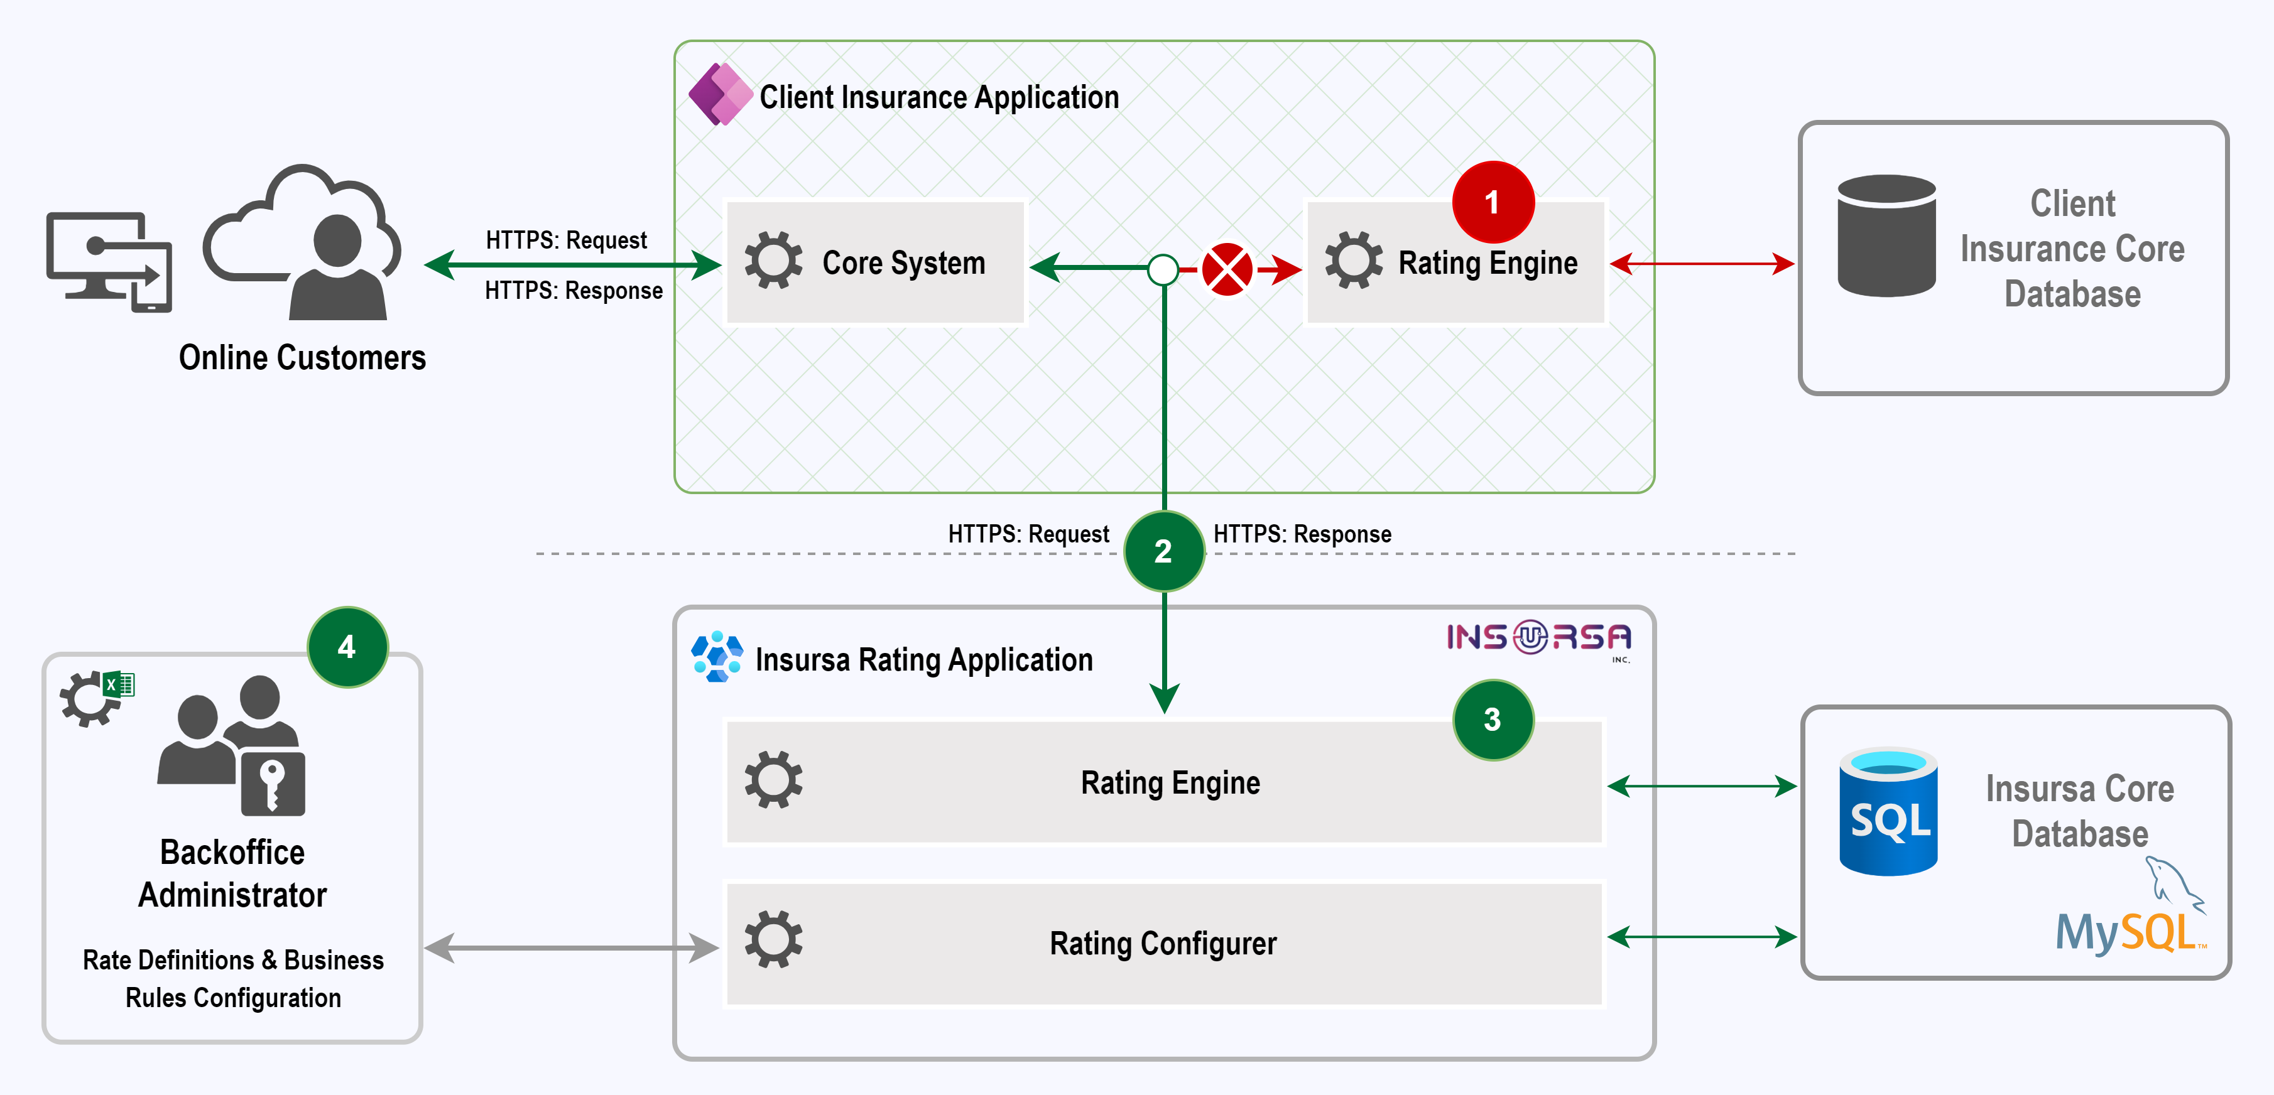
Third-Party Integration
@Client Core Insurance System
Decoupling of the client internal rating engine
1
2
@Insursa Premium Rating API
Client core system invokes Insursa premium rating API to obtain premium
3
@Insursa Premium Rating Engine
Computes premium based on the API request
4
@Backoffice Admin Console
Admin console allow client users to manage and upload multiple rating configurations
Notes:
Photos by rawpixel.com / Freepik

Slide 5
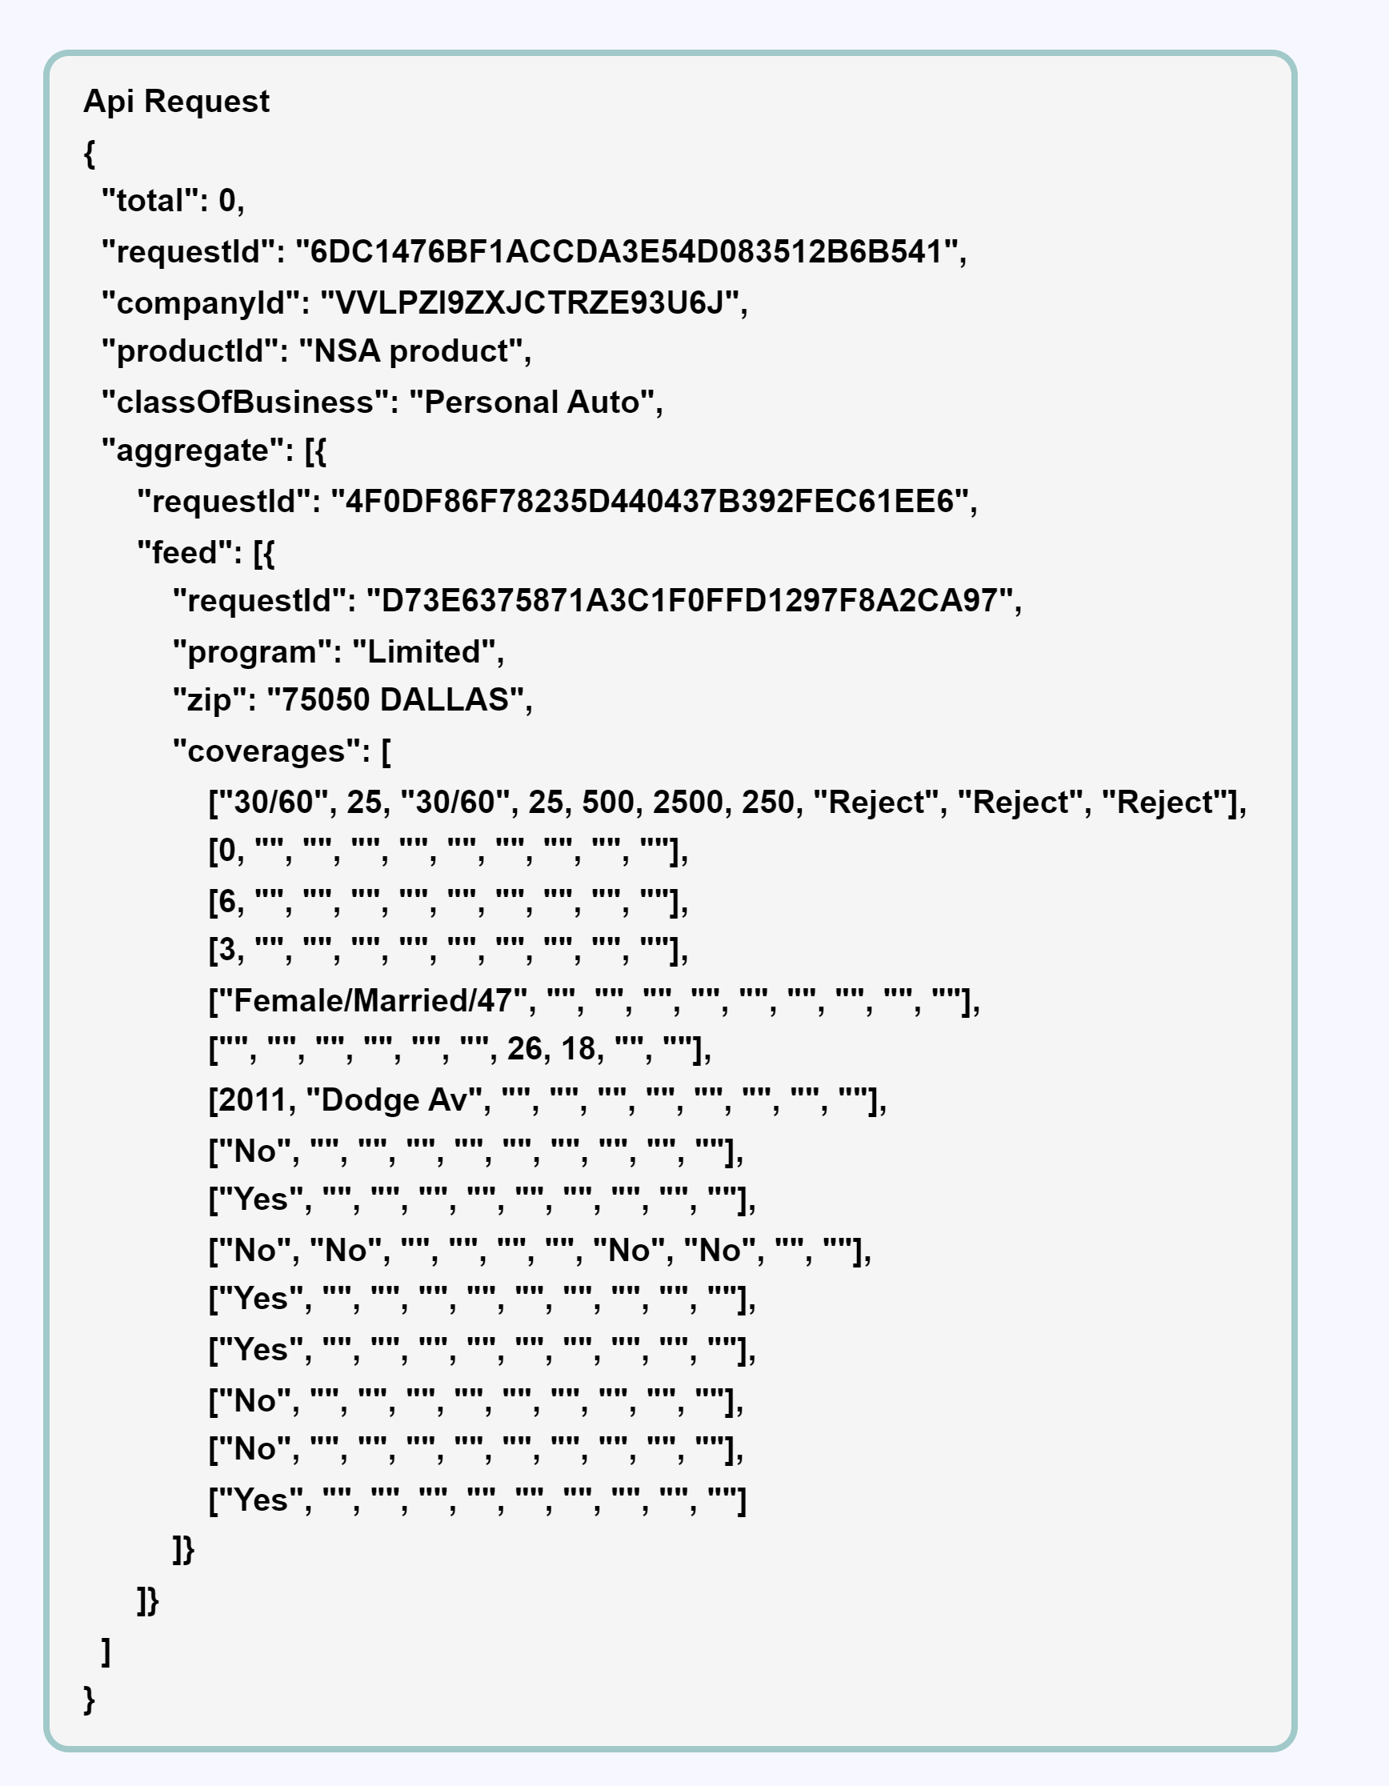
Api Request Header & Payload
An Authorization token must be obtained to verify identity and grant access to Api
@Request Payload Header
Information about which rating algorithm rules to use for the specified company
@Feed Array
Premium for multiple quotes can be obtained in single request
@Coverage Details
Placeholder for Risks, coverage limits, deductibles, driver details etc.
Api Authorization Header
A token must be obtained to access the premium rating Api
Content-Type | application/json
grant_type | client_credentials
client_id | insursa-client-app
client_secret | a2c53d65-3cd5-XXX-XX
@client_id / client_secret
Insursa to provide credentials for authorization server validation
@Authorization bearer token generated must be included in the Api request
Notes:
Photos by rawpixel.com / Freepik

Slide 6
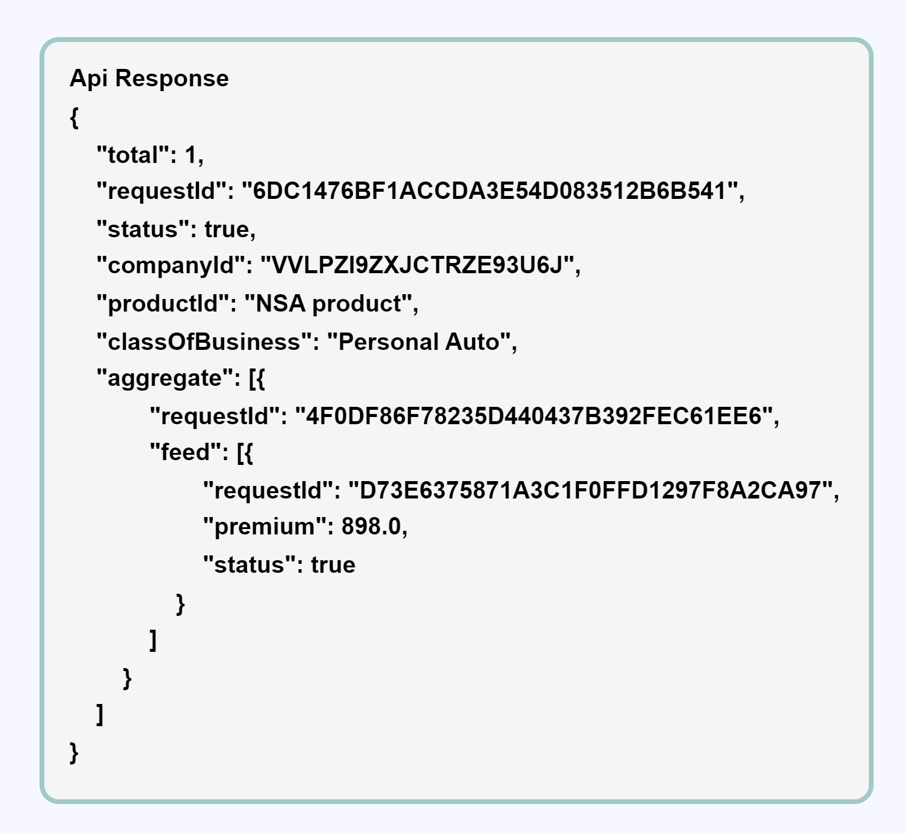
Api Request Header & Response Payload
An Authorization bearer token must set in request header to avoid 401 unauthorized error
@requestId
Unique identifier to uniquely identify and distinguish individual request
Api Request Header
An authorization token must be set in the request header of the Api
Content-Type | application/json
Processor-Type | TURBO
Response-Type | PREMIUM-ONLY
Authorization | Bearer XXX
@Processor-Type
TURBO used for bulk requests
SIMPLE used for few requests
@feed array
Multiple premiums can be obtained in single request
@RESPONSE-TYPE
This is an optional param if not present returns corresponding quote payload in the response
@premium
A valid premium is return in the response when the status is true
@Authorization
Must set a valid access_token received from authorization server
@PROCESSOR-TYPE: TURBO is recommended only while requesting for large number of quotes
Notes:
Photos by rawpixel.com / Freepik

Slide 7
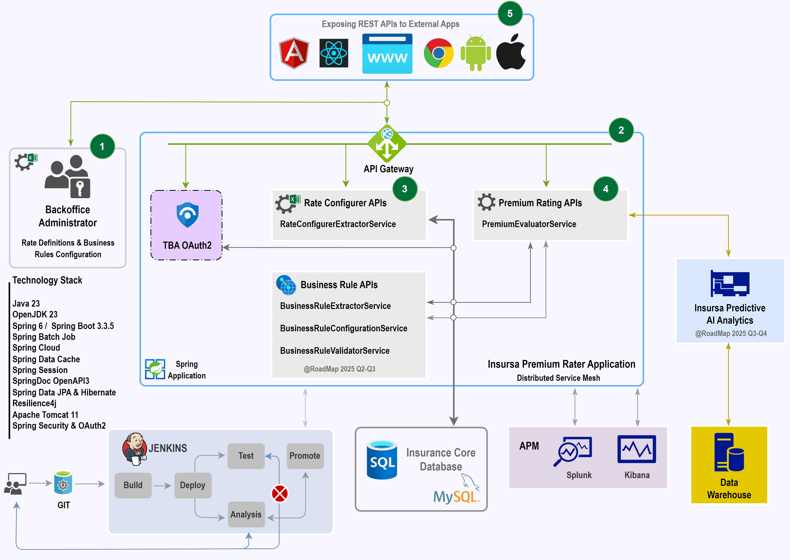
Product Architecture
1
@Backoffice Management Console
Client user customizes and configures rating for various products using online application.
2
@Premium Rating Application
Insursa rating application tool for computing premium for various products configured via Online Backoffice application.
3
@Rating Configurer APIs
Extracts risks factors, algorithm and formulas from the uploaded excel saves it into db.
4
@Premium Rating APIs
Allow third-party application to consume the rating Api for computing premium for various products configured via online Backoffice application.
5
@Client Application
Third-party authorized application sends payload request originated from various device apps consumes premium rating Api to compute premium
7
Notes:
Photos by rawpixel.com / Freepik

Slide 8




Product Business Benefits
Time to market
Accuracy
Reliability
Innovation
In highly competitive markets where time-to-market is crucial. ​Our rating product helps businesses focus on building their core products.
Development and Quality Assurance processes ensures our product is accurate functions as intended leads to improve customer experience, increase sales and reduce operational costs
Built on cutting edge technology reduce the risk of system malfunctions or failures perform resiliently even when receiving large volume of simultaneous requests
Continue to strive for excellence our future roadmap helps businesses stay competitive and increase customer engagement
Notes:
Photos by rawpixel.com / Freepik

Slide 9
Product RoadMap – Business Rules
Dec 2024
Feb 2025
Mar 2025
Apr 2025
Planning & Analysis
Requirement
Design & Development
Build
Test
Deploy
Clarifies objectives
Define project scope, budget, and timeline
Aligns stakeholders' expectations
Risk assessment
Project schedule
Scope & Timeline
Stakeholder Req.
Business Req.
Functional Req
Non-functional requirements
TBD
TBD
TBD
TBD
Notes:
Photos by rawpixel.com / Freepik

Slide 10
Product RoadMap – Predictive AI Analytics
Dec 2024
Mar 2025
Aug 2025
Nov 2025
Analysis
Requirement
Design & Development
Build
Test
Deploy
Clarifies objectives
Define project scope, budget, and timeline
Aligns stakeholders' expectations
Risk assessment
Project schedule
Scope & Timeline
Stakeholder Req.
Business Req.
Functional Req
Non-functional requirements
TBD
TBD
TBD
TBD
Notes:
Photos by rawpixel.com / Freepik

Slide 11




THANK YOU
Sabarinathan R
Executive Vice President Sales & Client Services
sabari@insursa.com
contactus@insursa.com
Texas - USA | Dubai - UAE | Chennai - India
Notes:
Photos by Freepik

